Slide 1
Love Differently Series
1st week: Love at First Sight

Slide 2
How the world view Love?

Slide 3
Series Goal
At the end of the series we hope that we will have the proper mindset about love based on
biblical principles (Not on how the world view love) which will lead to a relationship that will Glorify God.

Slide 4
Why do we have to pursue this series?

Slide 5
Does your relationship with the opposite sex glorify God?

Slide 6
Does your relationship with the opposite sex glorify God?

Slide 7
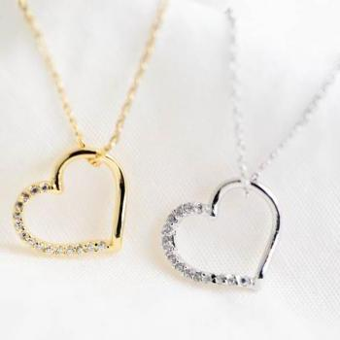
Have you ever had a sudden trouble in your life?

Slide 8
Word:
Samson went down to Timnah and saw there a young Philistine woman. When he returned, he said to his father and mother, “I have seen a Philistine woman in Timnah; now get her for me as my wife.” His father and mother replied, “Isn’t there an acceptable woman among your relatives or among all our people? Must you go to uncircumcised Philistines to get a wife?” But Samson said to his father, “Get her for me. She’s the right one for me.
Judges 14: 1-3

Slide 9
Word:
One day Samson went to Gaza, where he saw a prostitute. He went in to spend the night with her.
Judges 16: 1
Some time later, he fell in love with a woman in the Valley of Sorek whose name was Delilah.
Judges 16: 4

Slide 10
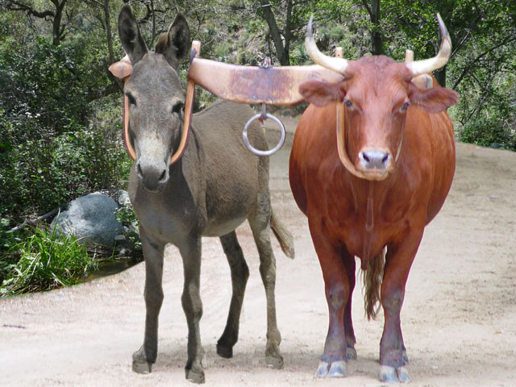
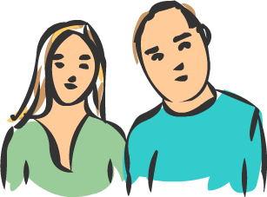
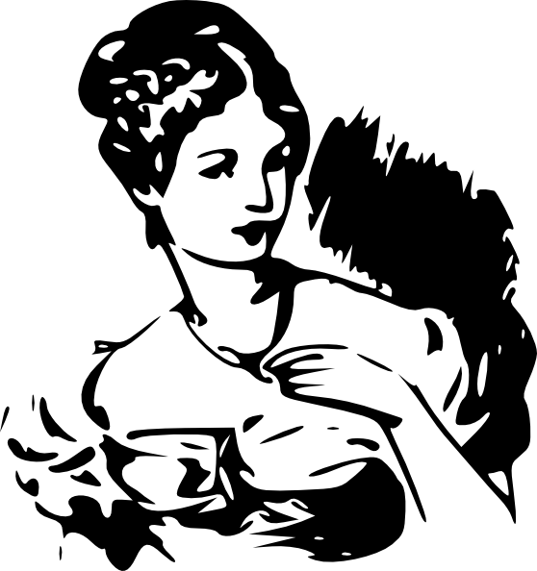
Girl from Timnah

Slide 11
Girl from Gaza

Slide 12
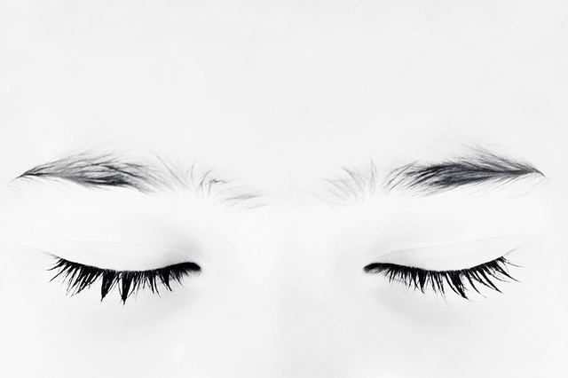
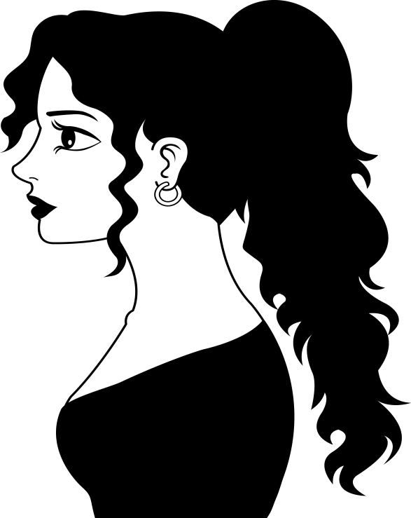
Delilah

Slide 13
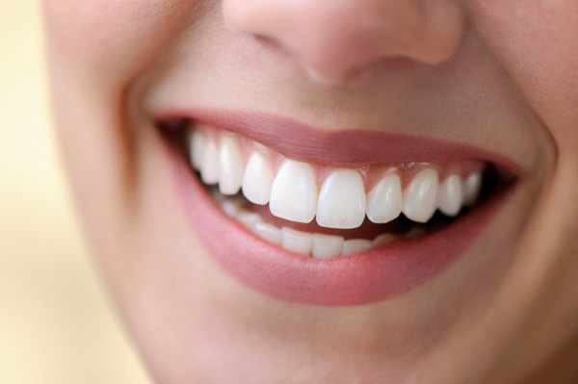
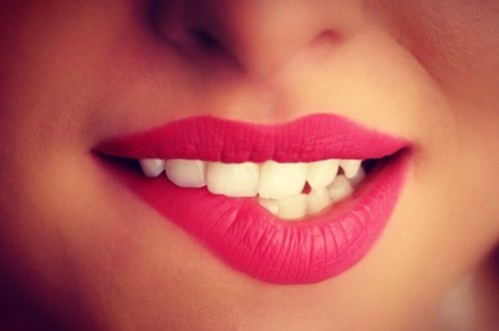
Love vs. Lust

Slide 14
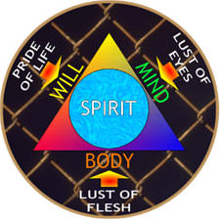
How Does Sin Attack?

Slide 15
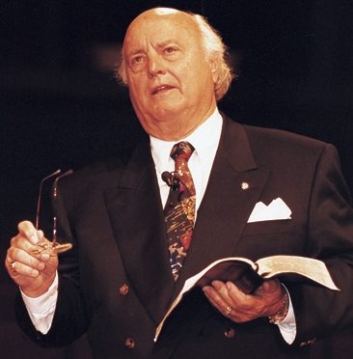
How can you turn lust to love?
“Love desire to benefit others at the expense of self, because love desires to give. Lust desires to benefit self at the expense of others, because lust desires to get.”
Edwin Louis Cole

Slide 16
Ending Remarks
Love like how God loved us.
John 3:16

Slide 17
Conclusion
We can love differently by imitating how God love us.

